Slide 1
Capstone Project: Predict Students' Dropout and Academic Success

Slide 2
CONTENTS
01
Data understanding, cleaning, and preprocessing
02
Exploratory Data Analysis (EDA) and initial model prototyping
03
•Model training, hyperparameter tuning, and addressing class imbalance.
04
Final model evaluation, report preparation, and presentation.

Slide 3
Data understanding, cleaning, and preprocessing
01

Slide 4


Problem Understanding
Target Variable: Target
Features:Marital Status,Application mode,Application order,Course,Daytime/evening attendance,Previous qualification,Previous qualification (grade),Nationality,Mother's qualification,Father's qualification,Mother's occupation,Father's occupation,Admission grade,Displaced,Educational special needs,Debtor,Tuition fees up to date and so on.

Slide 5

Define the model
three category classification task.
build classification models to predict students' dropouts and academic success

Slide 6
Cleaning the data
Look at the empty value
Transform the categorical value
We first look at the empty value of each column and there is none
Drop out to 0;
Graduate to 1;
Enrolled to 2.

Slide 7

Cleaning the data
Removing outliers
We remove outliers by setting the upper bound and lower bound by three stand deviations.

Slide 8
Exploratory Data Analysis (EDA) and initial model prototyping
02

Slide 9
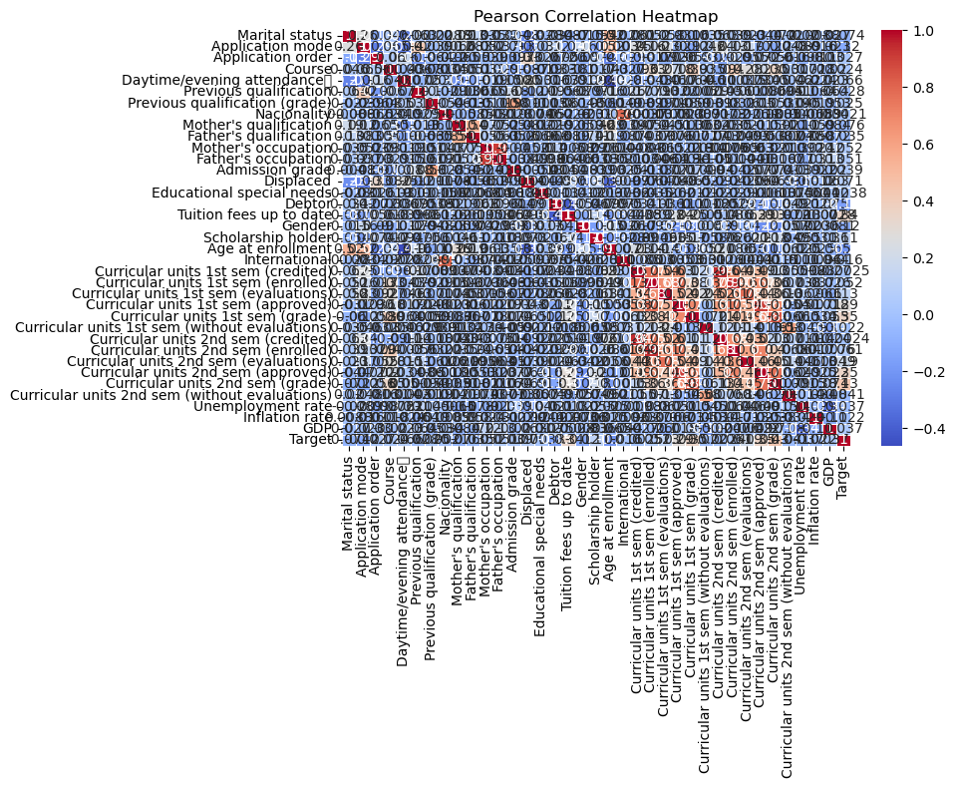
Pearson Correlation Heatmap
Heatmap
From the heat map, it’s easy to tell from the colors that -0.2 to 0.2 means little correlation, 0.2 to 0.4 means positive median correlation and 0.4 to 1 means positive strong relationship. In this case, Curricular units in 1st and 2nd term showed positive relationship with student academic success. In the plot, it’s easy to tell that there are too many dimensions in the dataset, so it’s important to use dimension reducing techniques such as PCA.

Slide 10
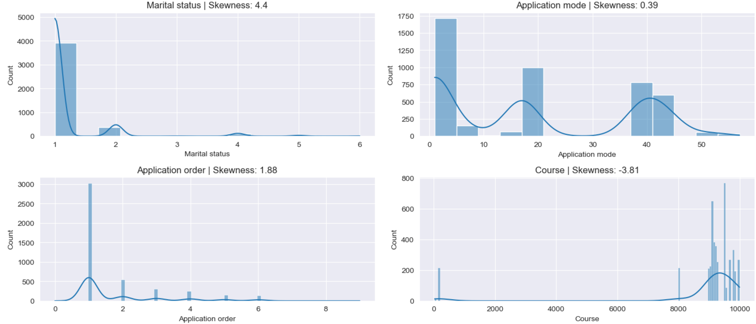
Density Plot
Secondly, we employed density plot to check the distribution and skewness of our variables. There are several findings. For example, most of our data are single Portuguese.

Slide 11
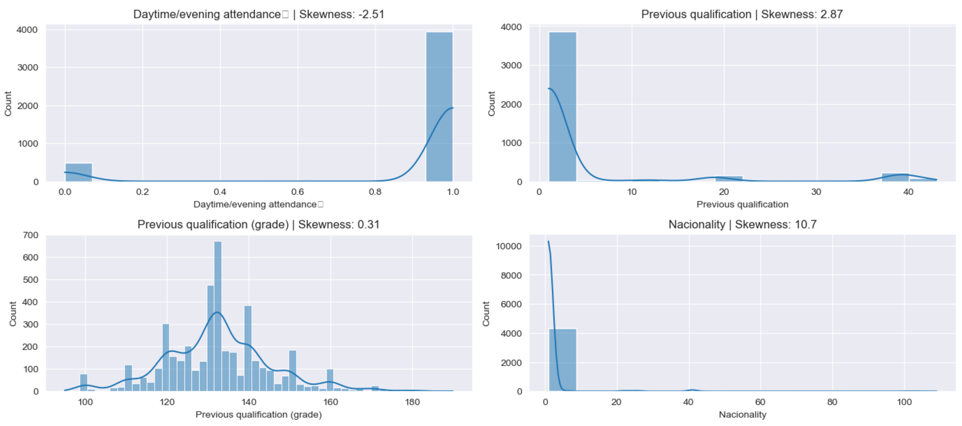
Density Plot
What’s more, most of our data are first choice. Most of our students’ previous education is around 130, which looks like normal distribution.Most of our students are daytime participants.More findings and plots are recorded in the jupyter notebook.

Slide 12
•Model training, hyperparameter tuning, and addressing class imbalance.
03

Slide 13
PCA
There are more than 10 variables such as nationality, previous qualification, daytime/evening attendance in the dataset. Not all are closely related with our target variables. Therefore, we should first reduce the dimension of the data for further studies. Principal component analysis, is a useful tool to put a large dataset into a small dataset, while still maintains its key feature of the dataset. When choosing the number of principal components (k), we choose k to be the smallest value so that for example, 99% of variance, is retained. As stated in the jupyter notebook, when k equals 1, we retained nearly 99% of the variance.

Slide 14
Final model evaluation, report preparation, and presentation.
04

Slide 15
confusion matrix for gradient boosting model
Looking at confusion matrix for gradient boosting model, there are 87 models in testing set who are drop are successfully predicted as drop, 93 models in testing set who are drop are predicted as enrolled, 19 models models in testing set who are drop are predicted as graduate. There are there are 99 models in testing set who are graduate are predicted as drop, 196 models in testing set who are graduate are predicted as graduate, 18 models in testing set who are graduate are predicted as enrolled. There are there are 51 models in testing set who are enrolled are predicted as drop, 196 models in testing set who are enrolled are predicted as graduate, 18 models in testing set who are enrolled are predicted as enrolled.
[[ 87 93 19]
[ 99 196 18]
[ 51 51 3]]

Slide 16
confusion matrix for random forest model
In confusion matrix for random forest model,there are 132 models in testing set who are drop are successfully predicted as drop, 0 models in testing set who are drop are predicted as enrolled, 67 models models in testing set who are drop are predicted as graduate. There are there are 157 models in testing set who are graduate are predicted as drop, 0 models in testing set who are graduate are predicted as graduate, 156 models in testing set who are graduate are predicted as enrolled. There are there are 74 models in testing set who are enrolled are predicted as drop, 0 models in testing set who are enrolled are predicted as graduate, 31 models in testing set who are enrolled are predicted as enrolled.
[[132 0 67]
[157 0 156]
[ 74 0 31]]

Slide 17
F1 score for gradient boosting model
Macro F1 score | 0.34692271928859886
Micro F1 score | 0.46353322528363045
Weighted F1 score | 0.46353322528363045

Slide 18
F1 score for random forest model
Macro F1 score | 0.21415094651347985
Micro F1 score | 0.26418152350081037
Weighted F1 score | 0.18089810661529884

Slide 19
Comparision
Now that we have completed data cleaning, model training and model evaluation steps. And in the evaluation step, we compared two models performance using F1 score and confusion matrix. Our conclusion is that gradient boosting model performs better than random forest model in F1 score and confusion matrix model in predicting students’ academic success.

Slide 20
Thanks
单击此处添加副标题内容

